Slide 1
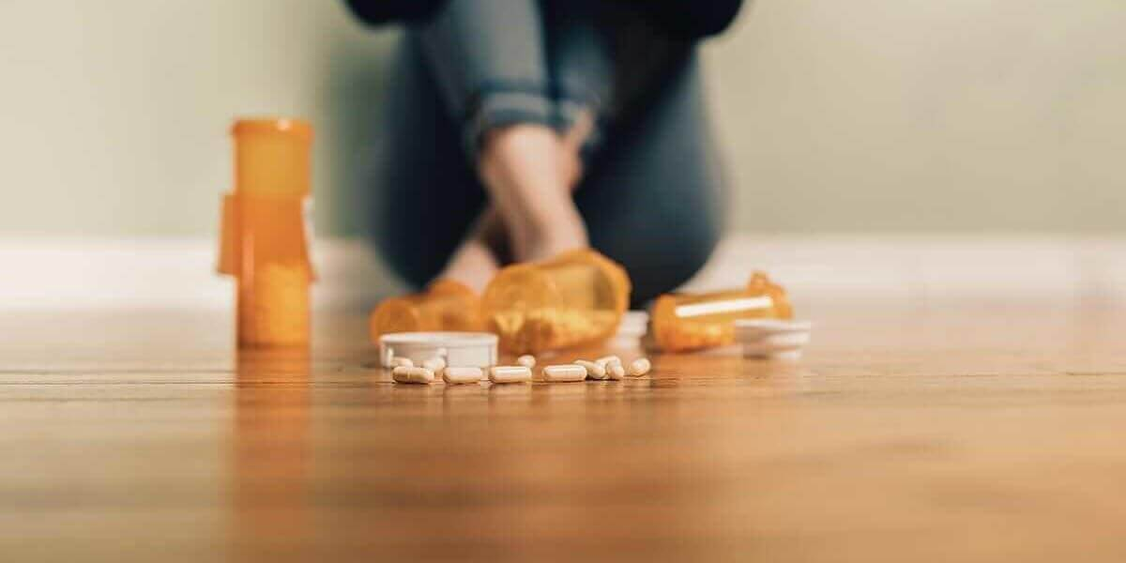
Prescriptions & overdose
Christian Alsider

Slide 2

Introduction
In the past addictions and overdoses were seen as “social class” problems.
The opiate crisis changed that. The dope dealer moved from the trap house to the doctor's office. Suddenly overdoses were no longer the panda eye junkie from a after school PSA, they have high functioning members of society who no one suspects has an addiction.
Was it the change in the prescribing habits of our providers?

Slide 3
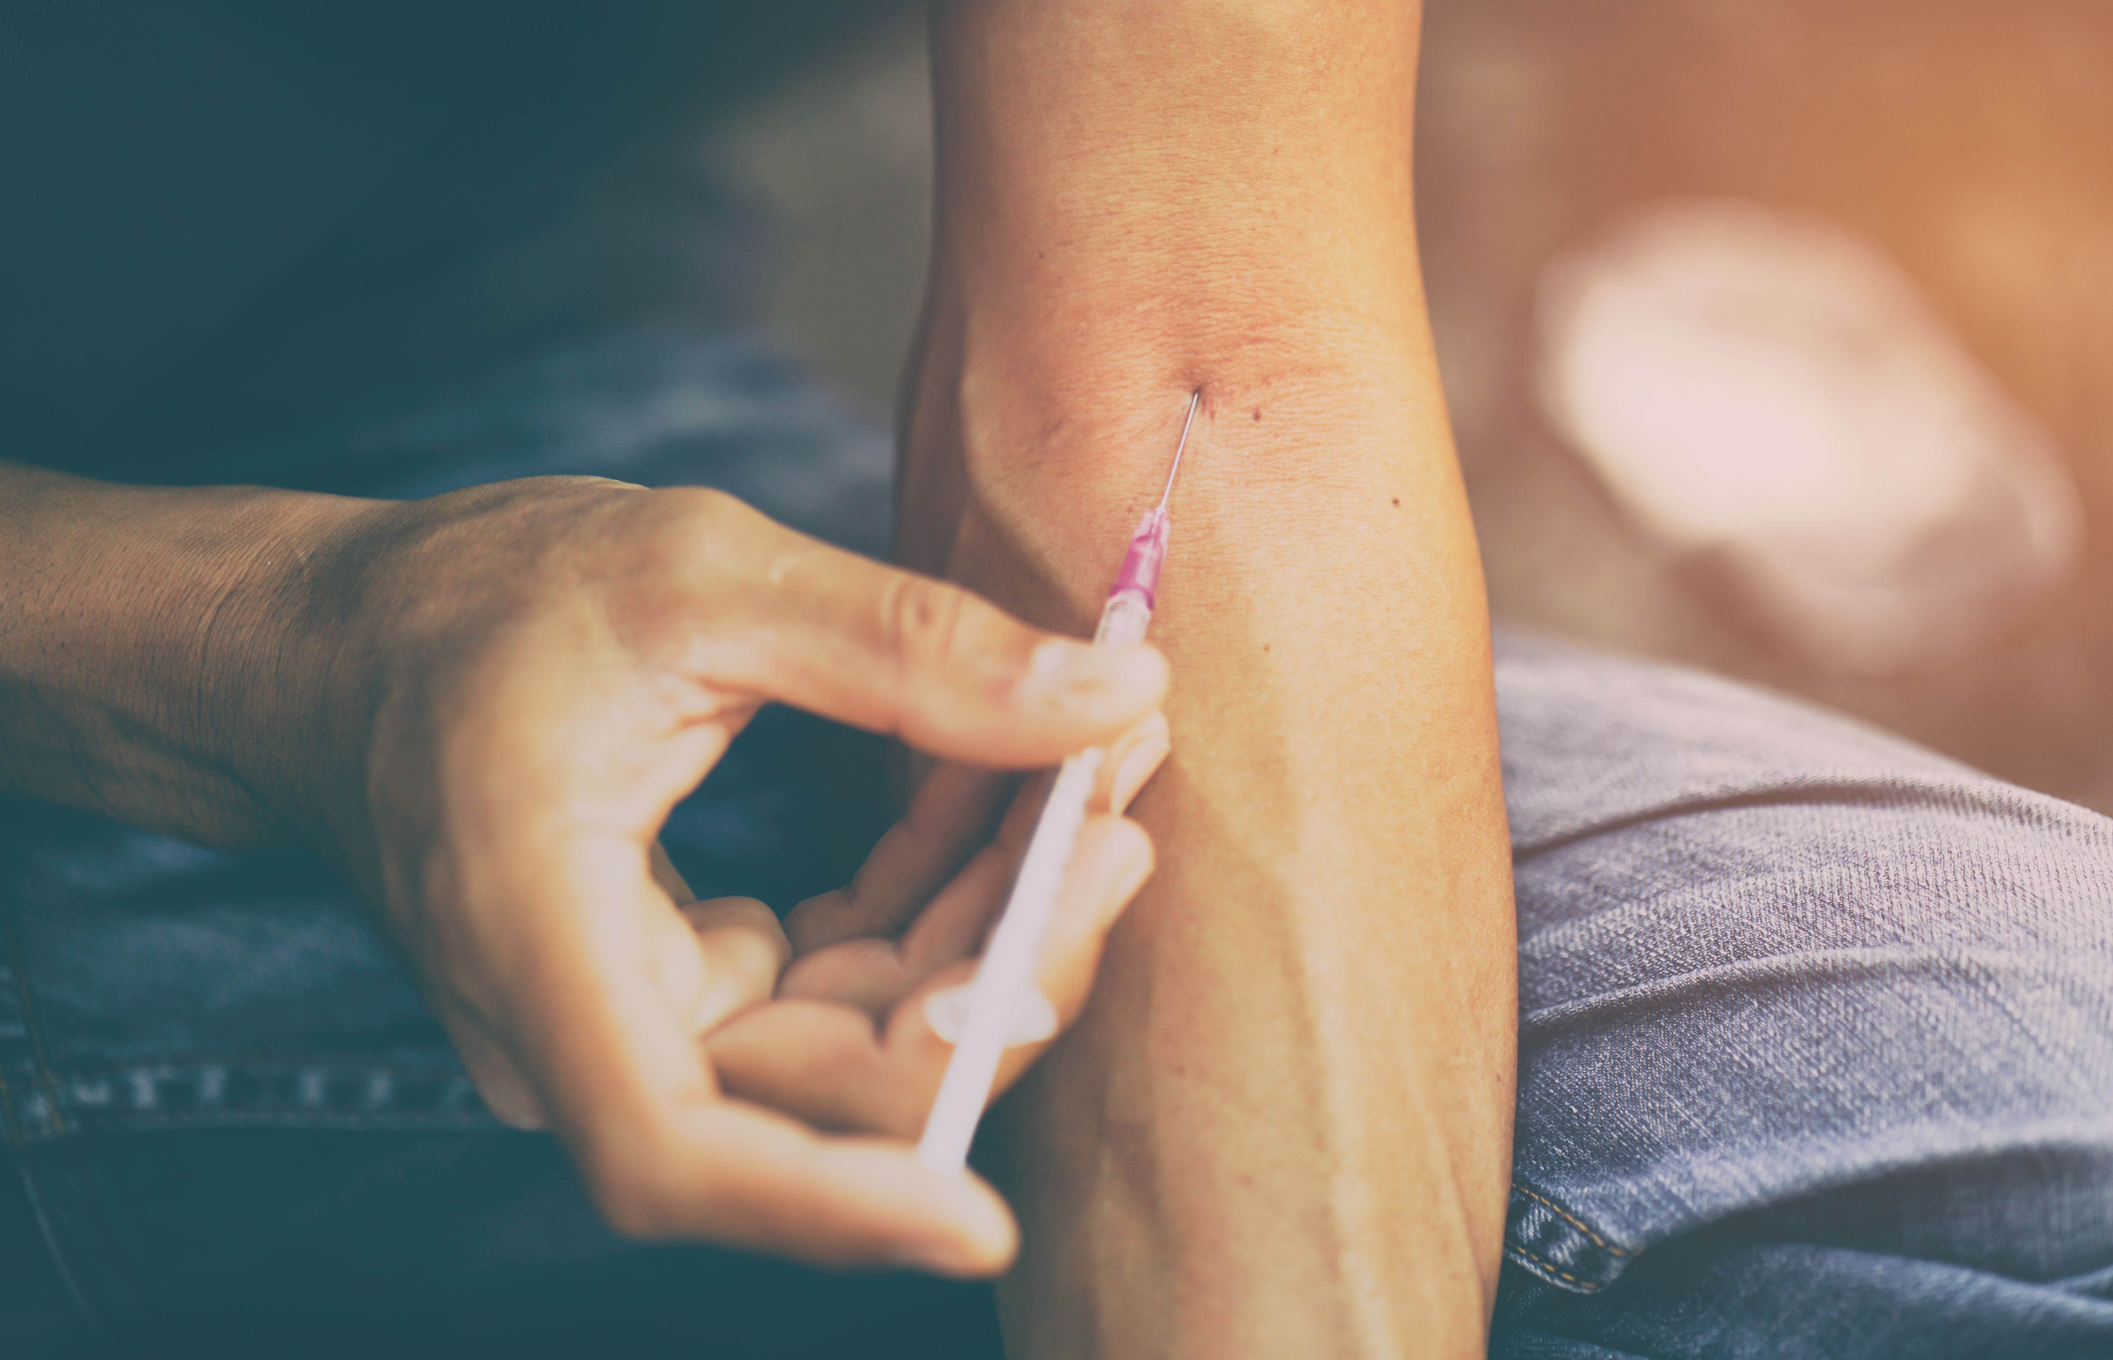
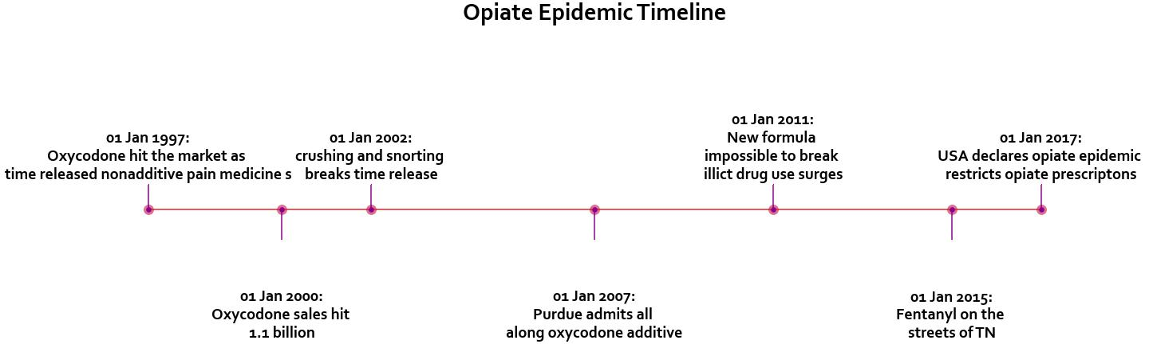
How did we get here?

Slide 4
1997 texthlkgj
2000
2007
2002
2011
2015
2017

Slide 5
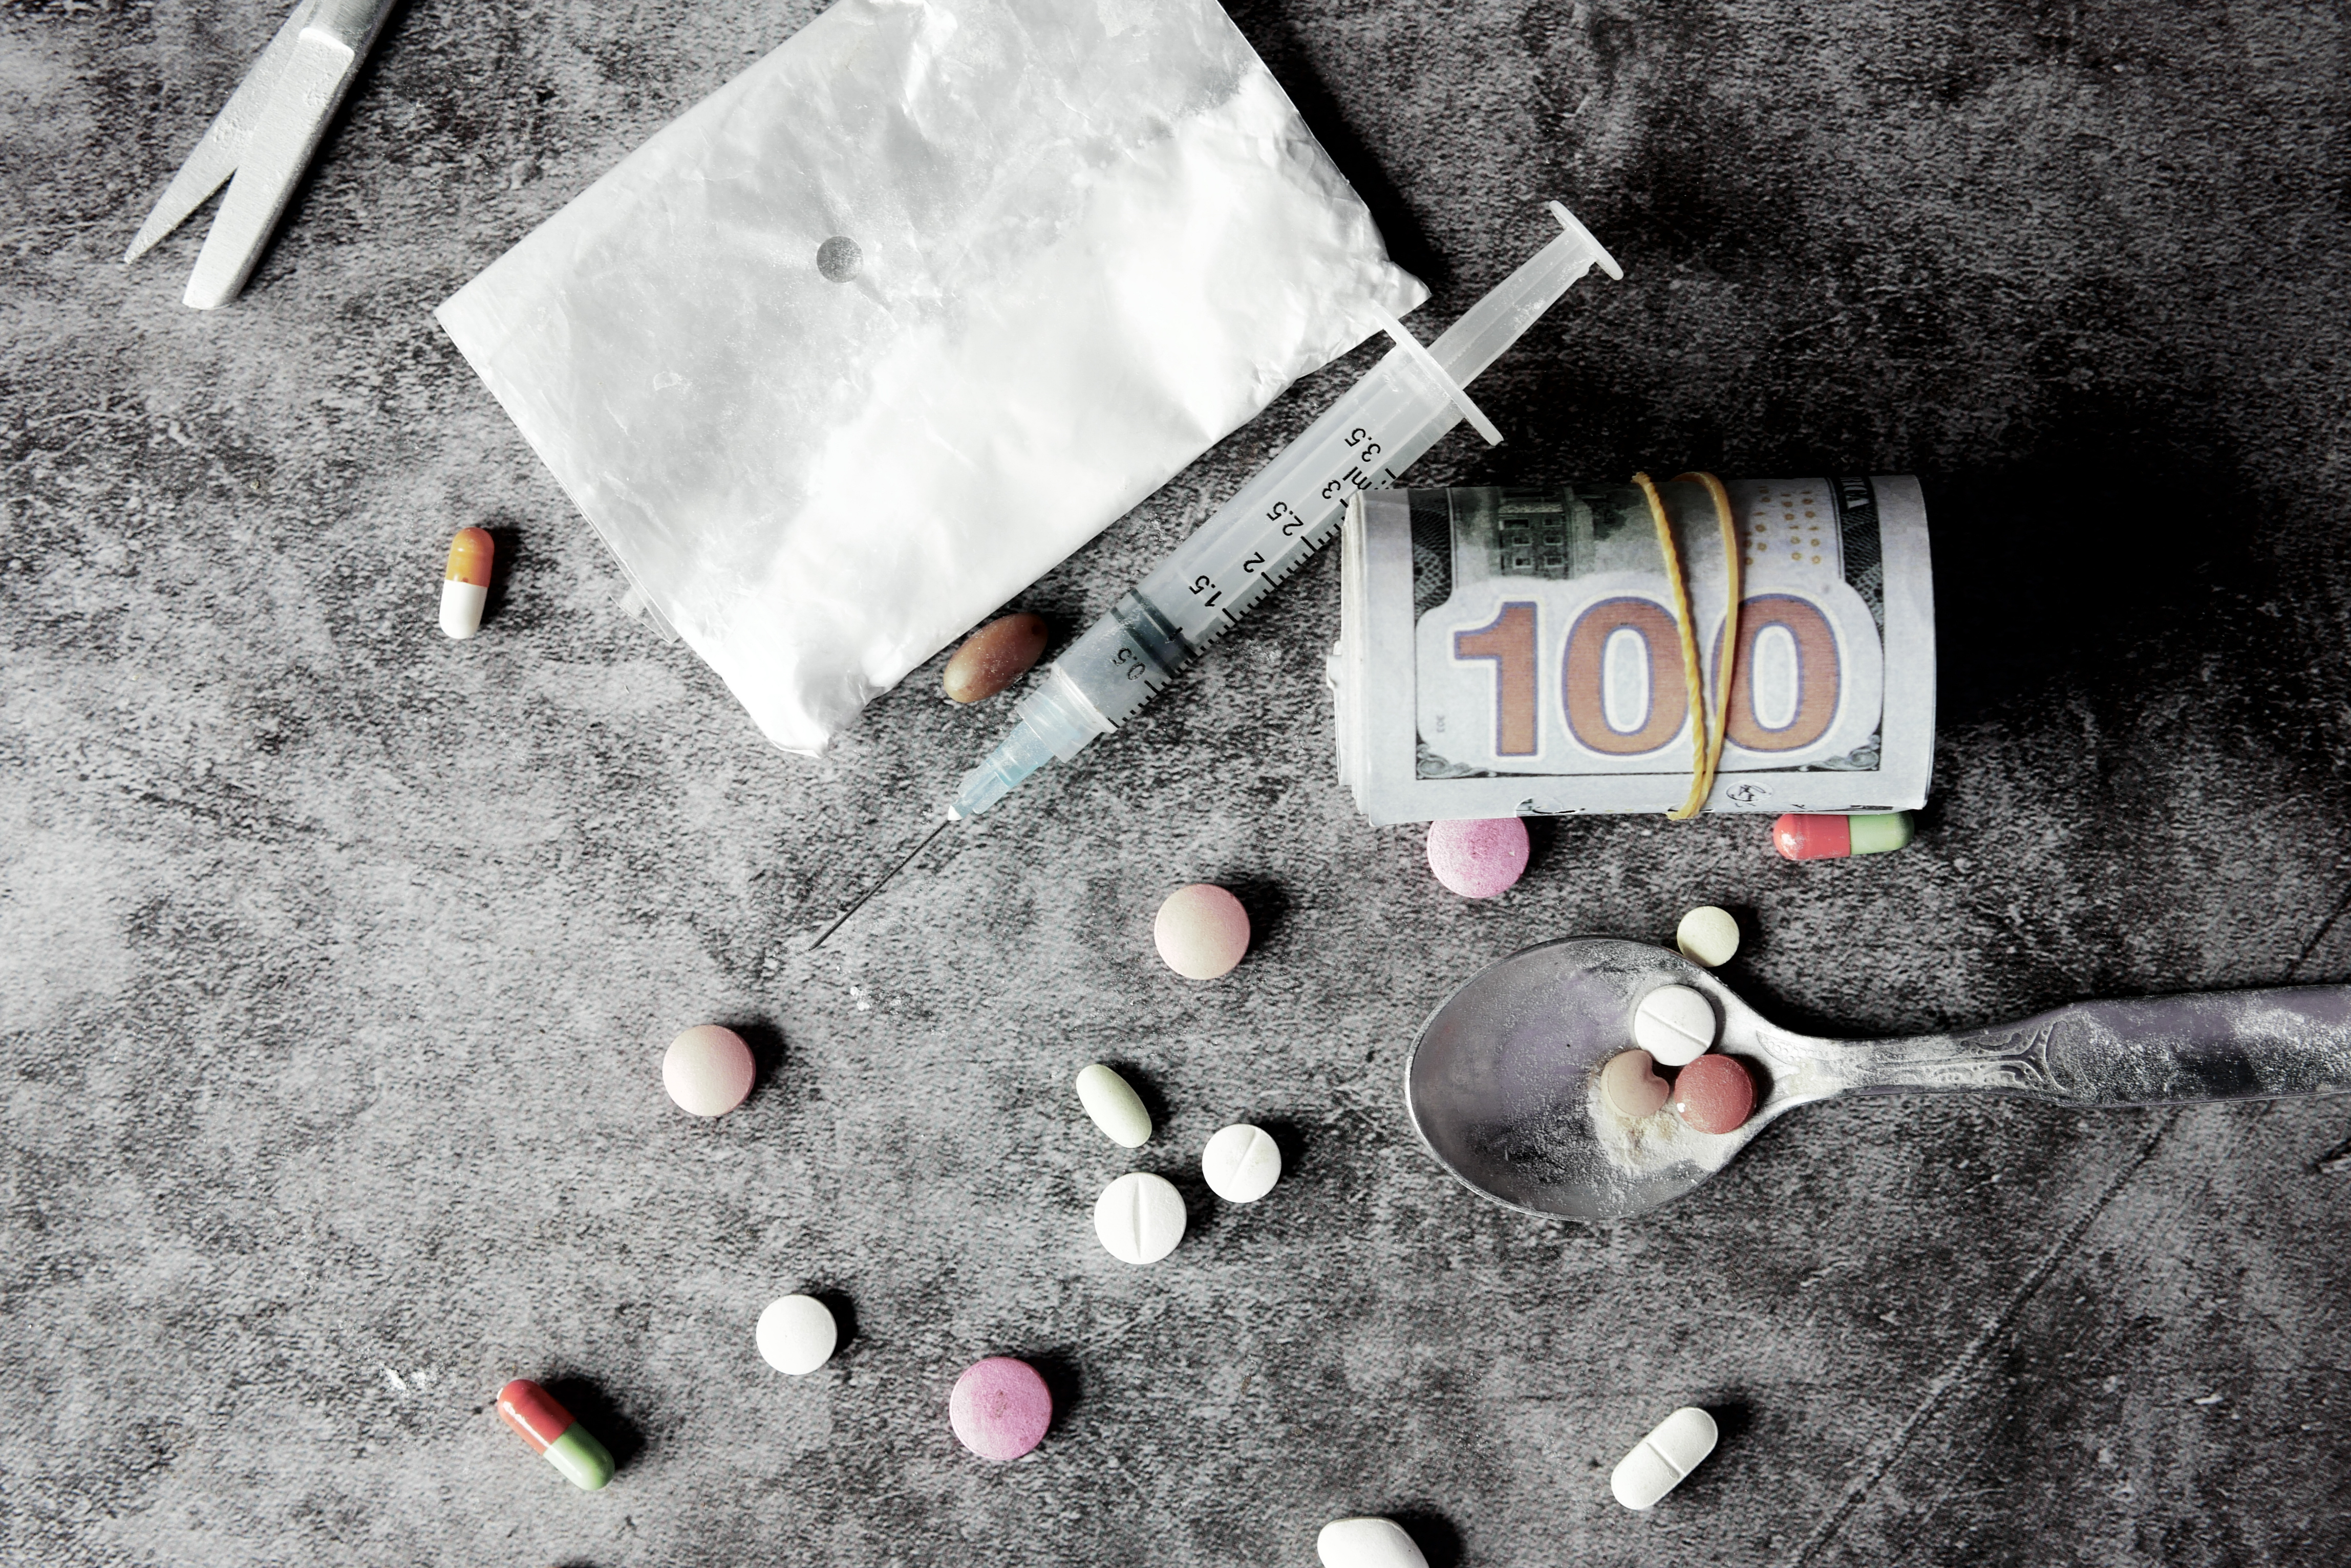
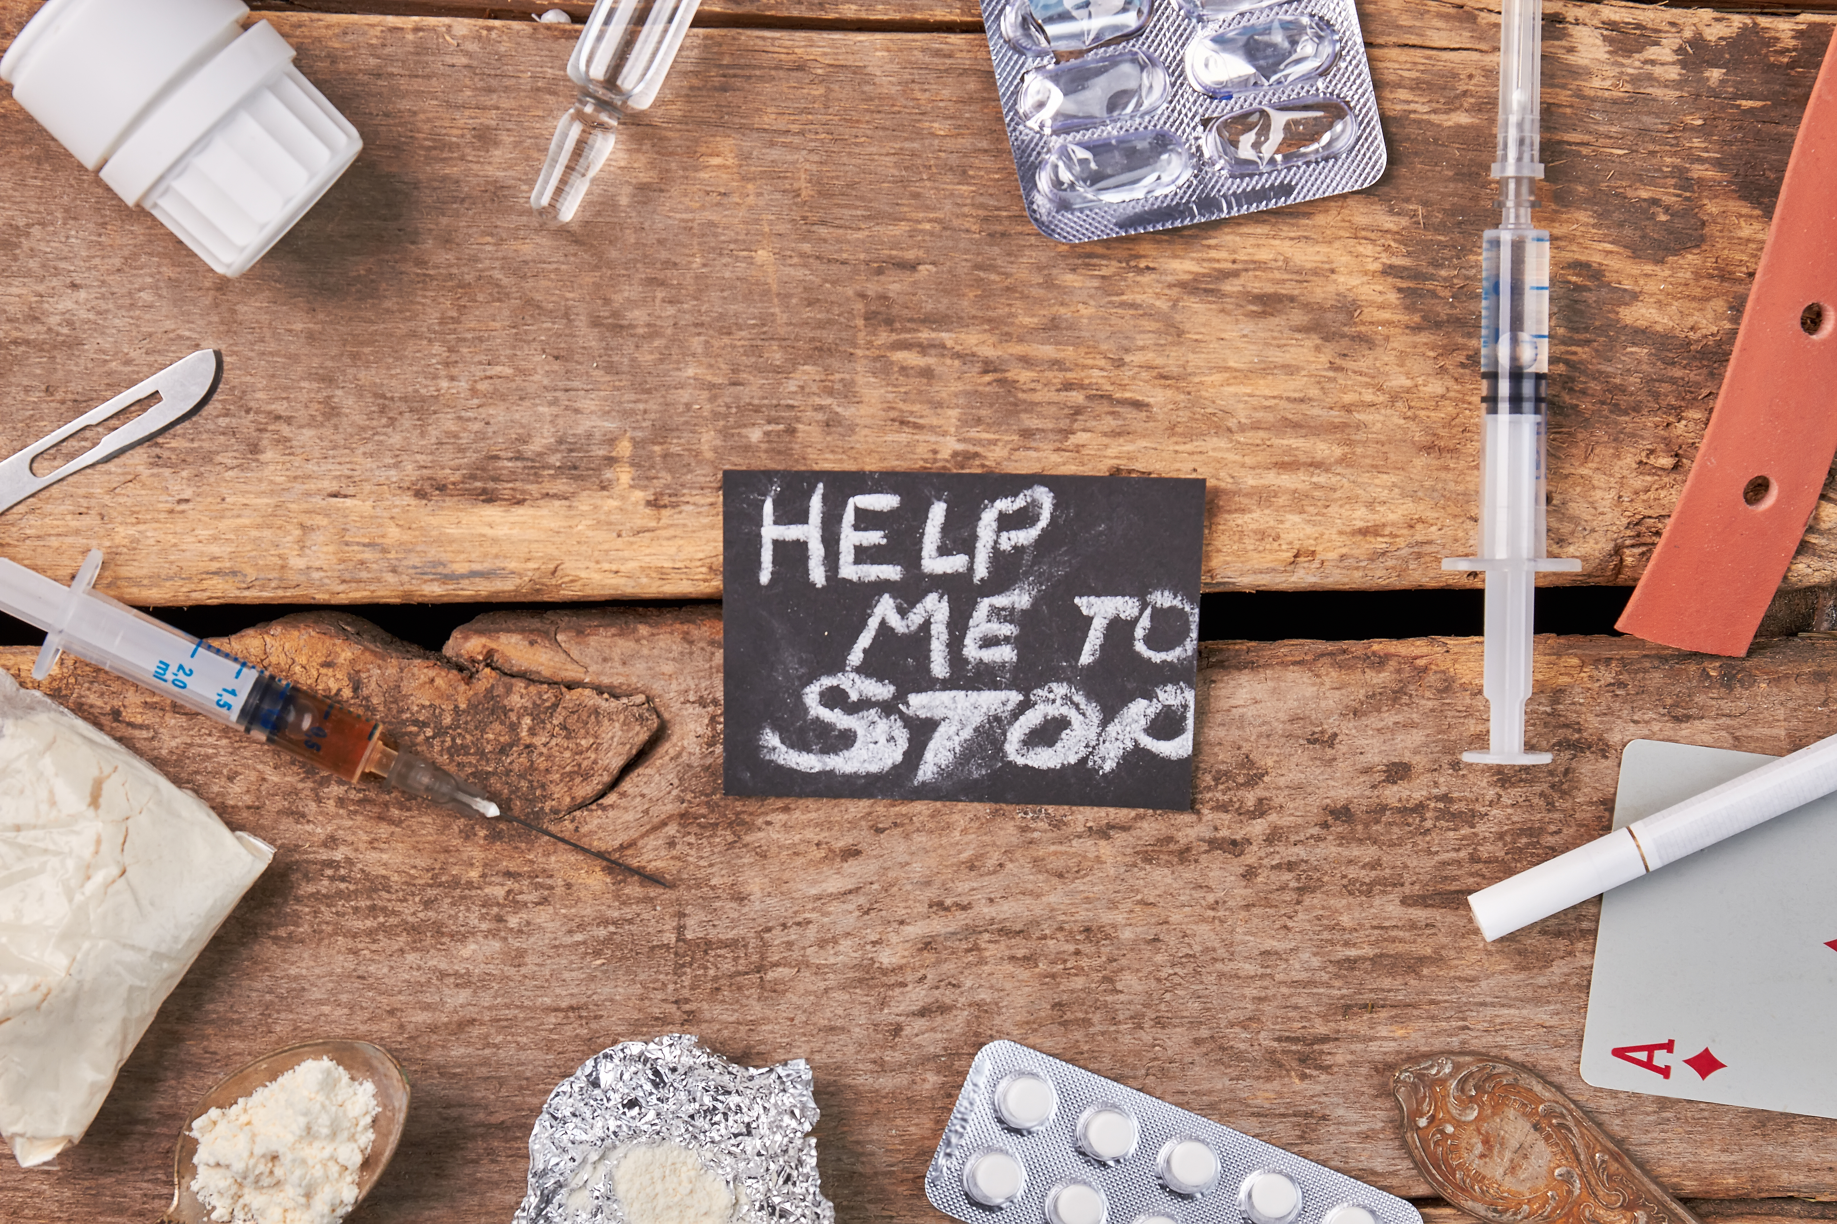
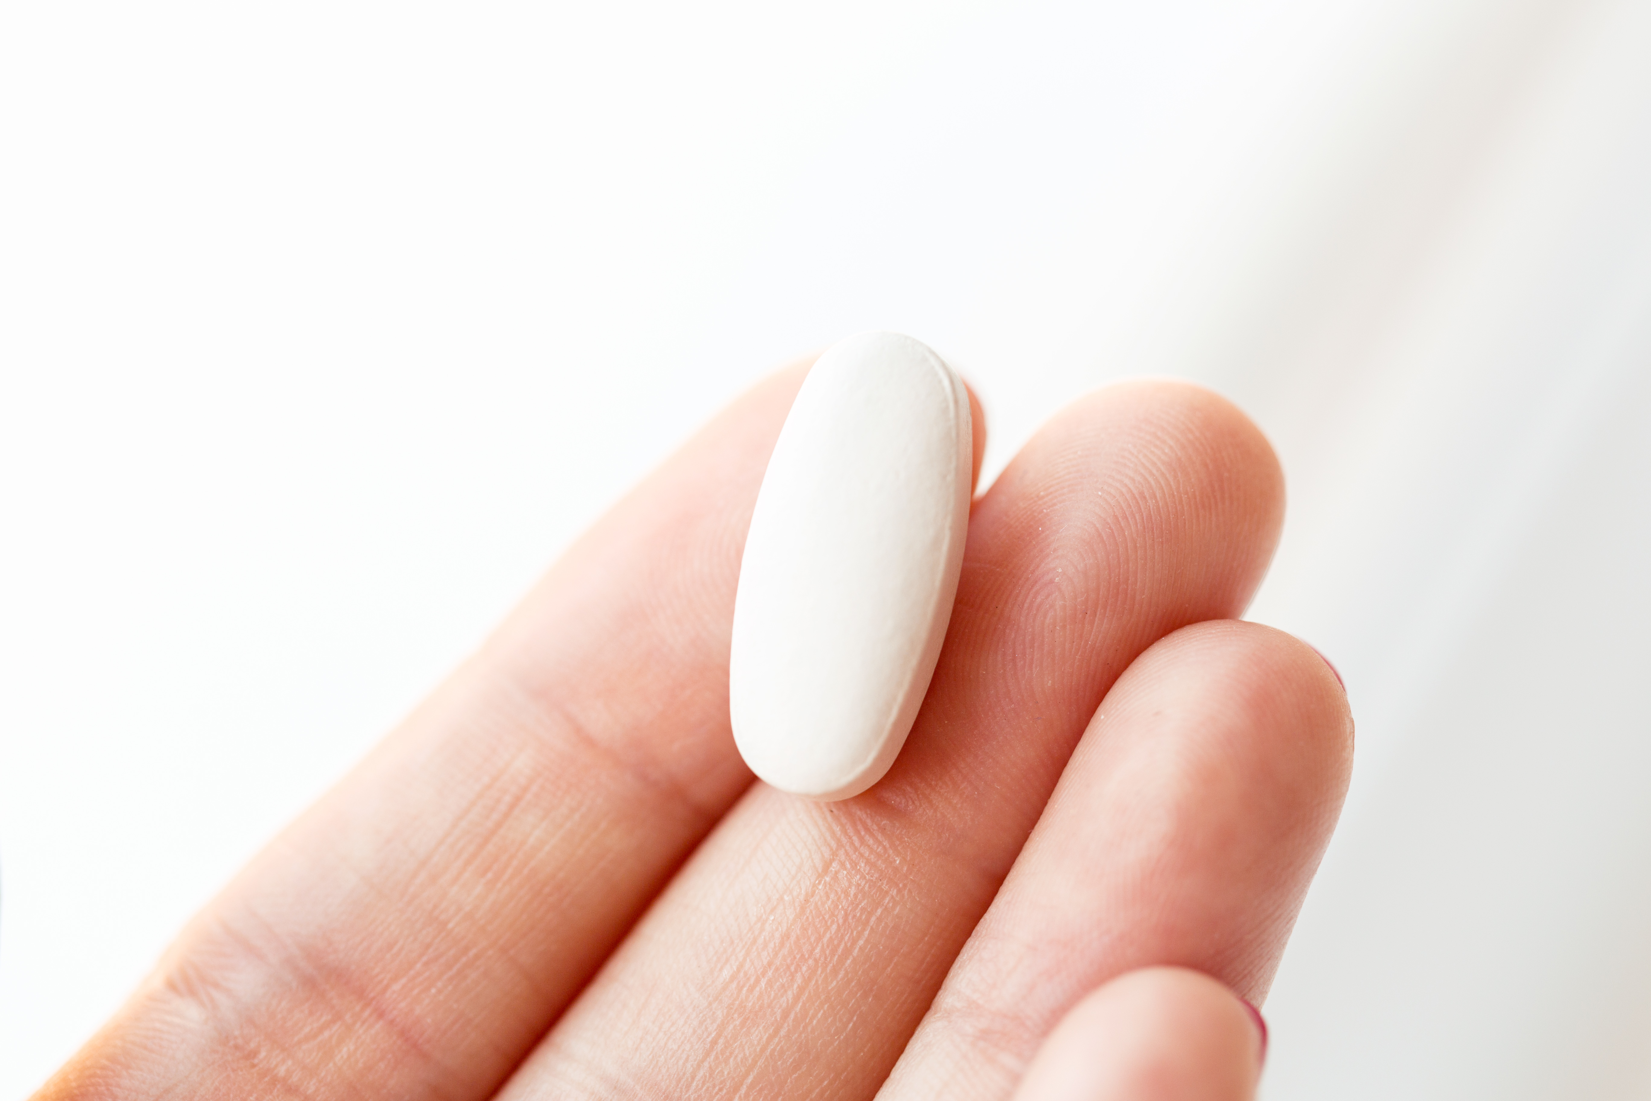
Prescribing trends

Slide 6
Opiate prescription's 2006-2020

Slide 7
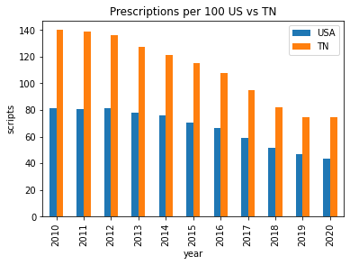
Table
Top 5 drugs tn by year
Top 5 counties for scripts with income

Slide 8
Prescriptions USA vs TN

Slide 9
Top Prescribed Drugs By Year

Slide 10
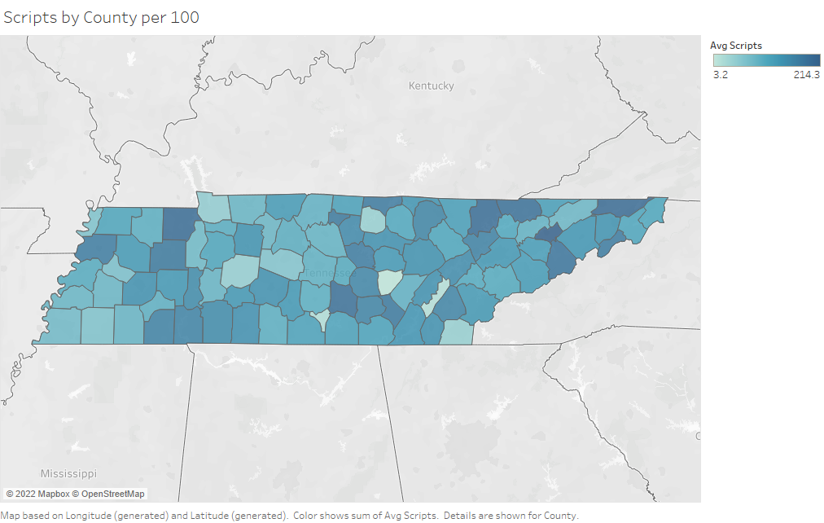

Slide 11
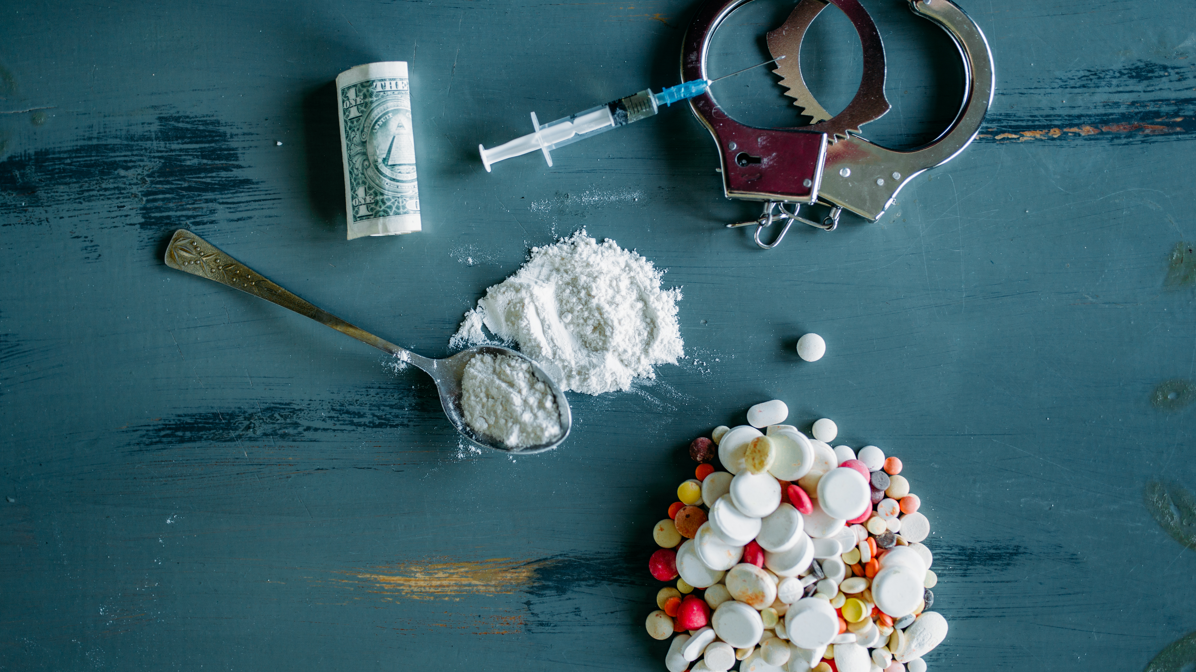
Fatal overdoses

Slide 12
Fatal overdoses USA 1980-2020

Slide 13
Fatal overdoses 2013-2020

Slide 14

The way to get started is to quit talking and begin doing.
Walt Disney
Non Fatal Overdoses
Fatal overdoses

Slide 15
Non-Fatal overdoses 2013-2020

Slide 16
Non-Fatal overdoses 2013-2020

Slide 17
Additional content
Subtitle
Subtitle
Subtitle
Add text, images, art, and videos.
Add transitions, animations, and motion.
Save to OneDrive, to get to your presentations from your computer, tablet, or phone.
Open the Design Ideas pane for instant slide makeovers.
When we have design ideas, we’ll show them to you right there.
This PowerPoint theme uses its own unique set of colors, fonts, and effects to create the overall look and feel of these slides.
PowerPoint has tons of themes to give your presentation just the right personality.

Slide 18


Thank you
Christian Alsider
christianlalsider@gmail.com
www.linkedin.com/in/christianalsider

